Slide 1

Loops
TUIT
C++ Programming, Fall 2016
Lecture #5

Slide 2
TUIT
Roadmap
Last week we covered
Mathematical Functions, Characters, and Strings
This week we will learn
Introduction
The while Loop
The do-while Loop
The for Loop
Which Loop to Use?
Nested Loops
Minimizing Numeric Errors
Case Studies
Keywords break and continue
Case Study: Checking Palindromes
Case Study: Displaying Prime Numbers

Slide 3
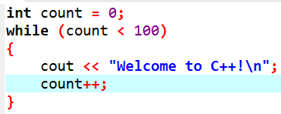
TUIT
Introduction
A loop can be used to tell a program to execute statements repeatedly.
Suppose that you need to display a string (e.g., “Welcome to C++!”) 100 times. It would be tedious to write the following statements 100 times:
cout << “Welcome to C++!\n”;
cout << “Welcome to C++!\n”;
…
cout << “Welcome to C++!\n”;
100 times

Slide 4
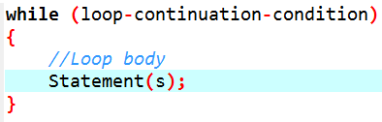
TUIT
The while Loop
A while loop executes statements repeatedly while the condition is true.
The syntax for the while loop is

Slide 5
TUIT
The while Loop
count = 0;
Loop-continuation-condition?
(count < 100)?
false
false
true
true
Statements(s)
(loop body)
cout << “Welcome to C++!\n”;
count++;
The while loop repeatedly executes the statements in the loop body when the loop-continuation-condition evaluates to true

Slide 6
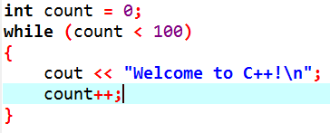
TUIT
The while Loop
loop-continuation-condition
loop body

Slide 7
TUIT
Note
The loop-continuation-condition must always appear inside the parentheses. The braces enclosing the loop body can be omitted only if the loop body contains one statement or none.

Slide 8
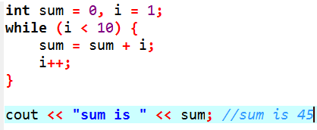
TUIT
The while Loop
Here is another example to help understand how a loop works:

Slide 9
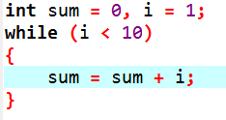
TUIT
The while Loop
What happens if the loop is incorrectly written as follows?

Slide 10
TUIT
Note
Make sure that the loop-continuation-condition eventually becomes false so that the loop will terminate. A common programming error involves infinite loops (i.e., the loop runs forever). If your program takes an unusually long time to run and does not stop, it may have infinity loop. If you are running the program from the command window, press CTRL+C to stop it.

Slide 11
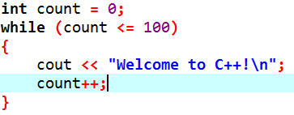
TUIT
Caution
Programmers often make the mistake of executing a loop one more or none less time. This is commonly known as the off-by-one error. For example, the following loop displays Welcome to C++! 101 times rather than 100 times. The error lines in the condition, which should be count < 100 rather than count <=100.

Slide 12
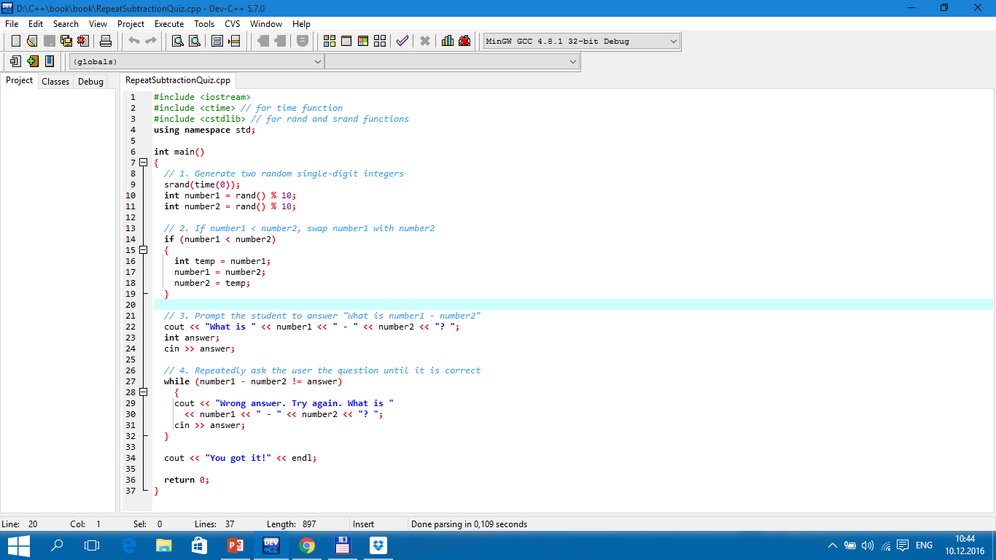


TUIT
Example
What is 4 – 3? 4 Wrong answer. Try again. What is 4-3? 5 Wrong answer. Try again. What is 4-3? 1 Ypu got it!

Slide 13
TUIT
Case Study: Guessing Numbers
Guess a magic number between 0 and 100 Enter your guess: 50 Your guess is too high Enter your guess: 25 Your guess is too low Enter your guess: 42 Your guess is too high Enter your guess: 39 Yes, the number is 39
How do you write this program? Do you immediately begin coding? No. It is important to think before coding.

Slide 14
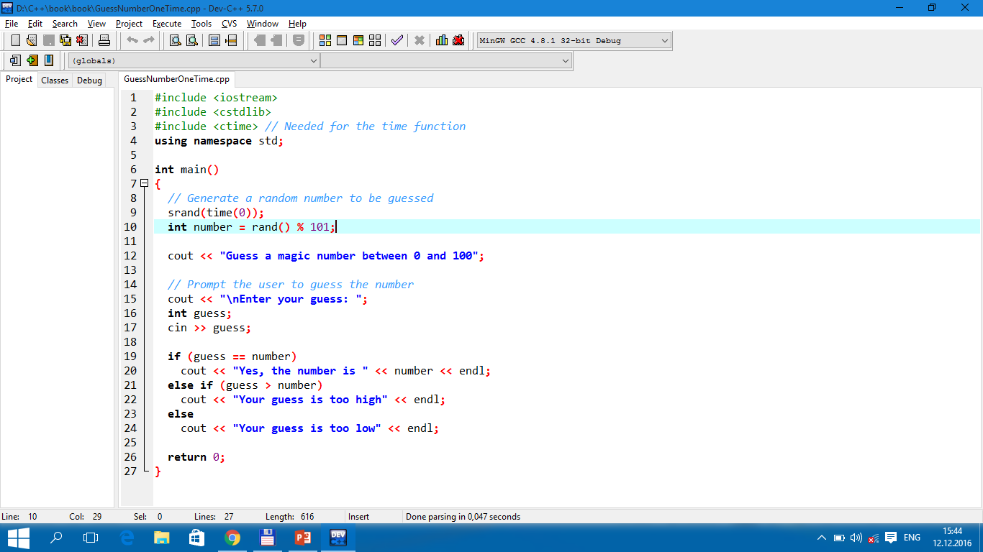
TUIT
Case Study: Guessing Numbers
Guess a magic number between 0 and 100 Enter your guess: 35 Your guess is too high

Slide 15
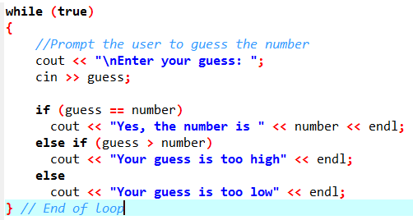
TUIT
Case Study: Guessing Numbers

Slide 16
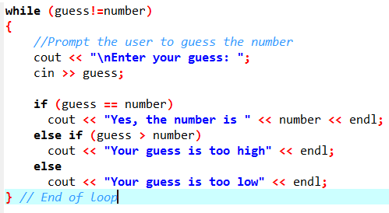
TUIT
Case Study: Guessing Numbers

Slide 17
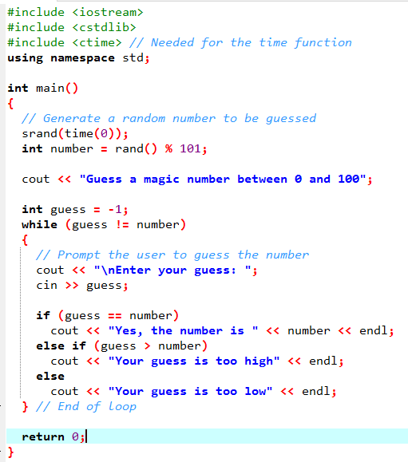
TUIT
Case Study: Guessing Numbers
Guess a magic number between 0 and 100 Enter your guess: 50 Your guess is too low Enter your guess: 75 Your guess is too low Enter your guess: 80 Your guess is too high Enter your guess: 78 Yes, the number is 78

Slide 18
TUIT
Loop Design Strategies
Writing a correct loop is not an easy task for novice programmers. Consider three steps when writing a loop.
Step 1: Identify the statements that need to be repeated.
Step 2: Wrap these statements in a loop as follows:
while (true)
{
Statements;
}
Step 3: Code the loop-continuation-condition and add appropriate statements for controlling the loop.
while(loop-continuation-condition)
{
Statements;
Additional statements for controlling the loop;
}

Slide 19
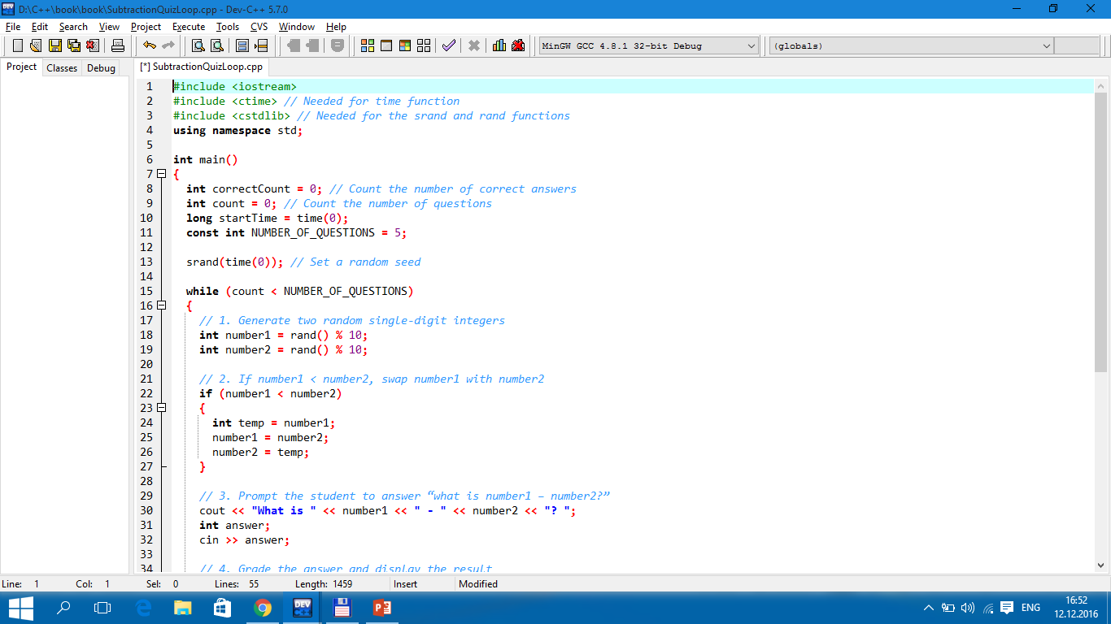
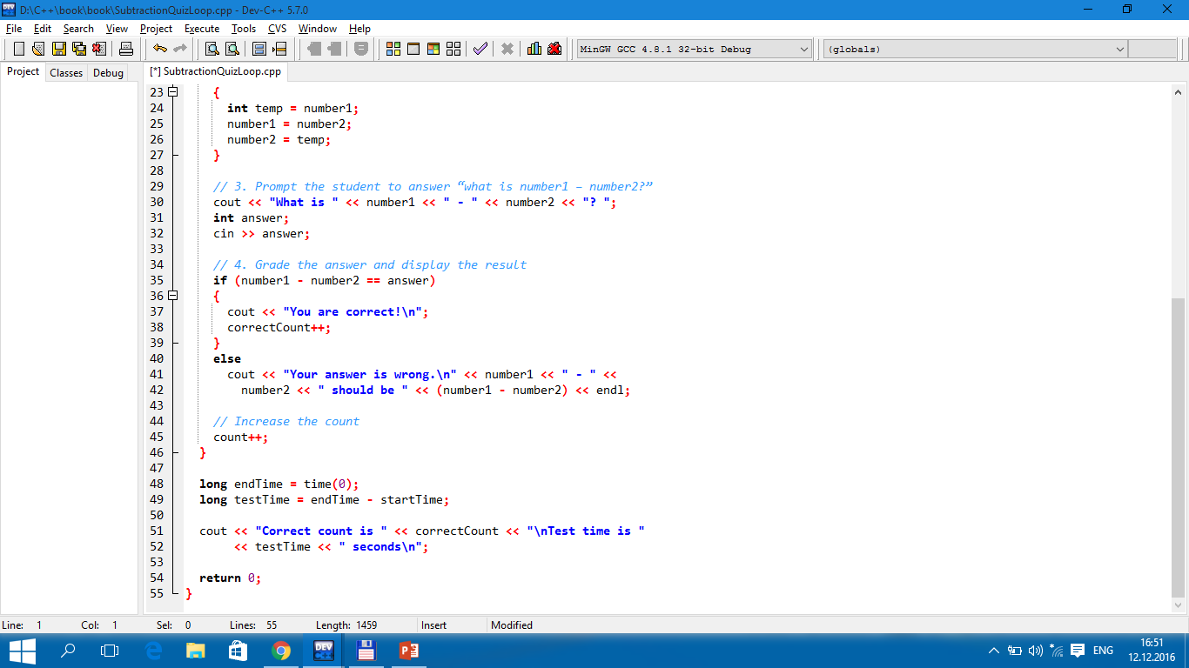
TUIT
Case Study: Multiple Subtraction Quiz

Slide 20
TUIT
Case Study: Multiple Subtraction Quiz
What is 9 – 2? 7 You are correct! What is 3 – 0? 3 You are correct! What is 3 – 2? 1 You are correct! What is 7 – 4? 4 You answer is wrong. 7 – 4 should be 3 What is 7 – 5? 4 You answer is wrong. 7 – 5 should be 2 Correct count is 3 Test time is 201 seconds

Slide 21
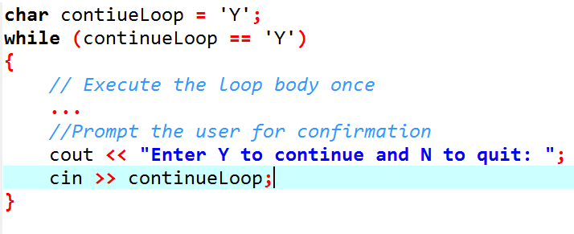
TUIT
Controlling a Loop with User Confirmation

Slide 22
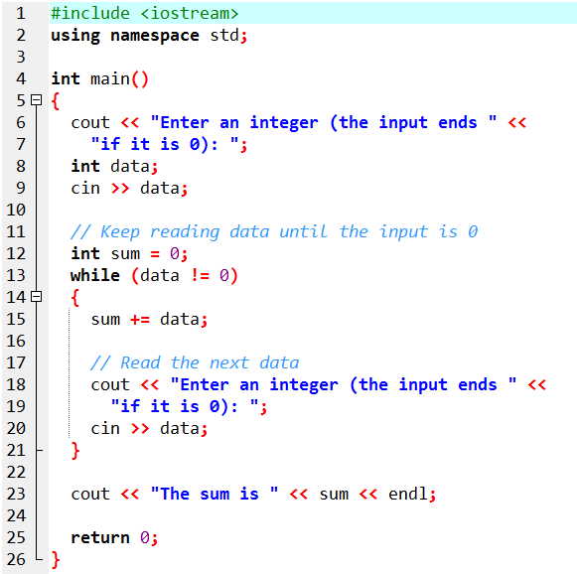
TUIT
Controlling a Loop with a Sentinel Value
Enter an integer (the input ends if it is 0): 2 Enter an integer (the input ends if it is 0): 3 Enter an integer (the input ends if it is 0): 4 Enter an integer (the input ends if it is 0): 0 The sum is 9

Slide 23
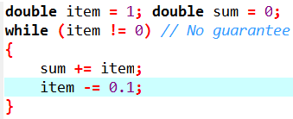
TUIT
Caution
Don’t use floating-point values for equality checking in a loop control expression. Because floating-point values are approximations for some values, using them can result in imprecise counter values and inaccurate results.
Consider the following code for computing 1 + 0.9 + 0.8 + … + 0.1

Slide 24
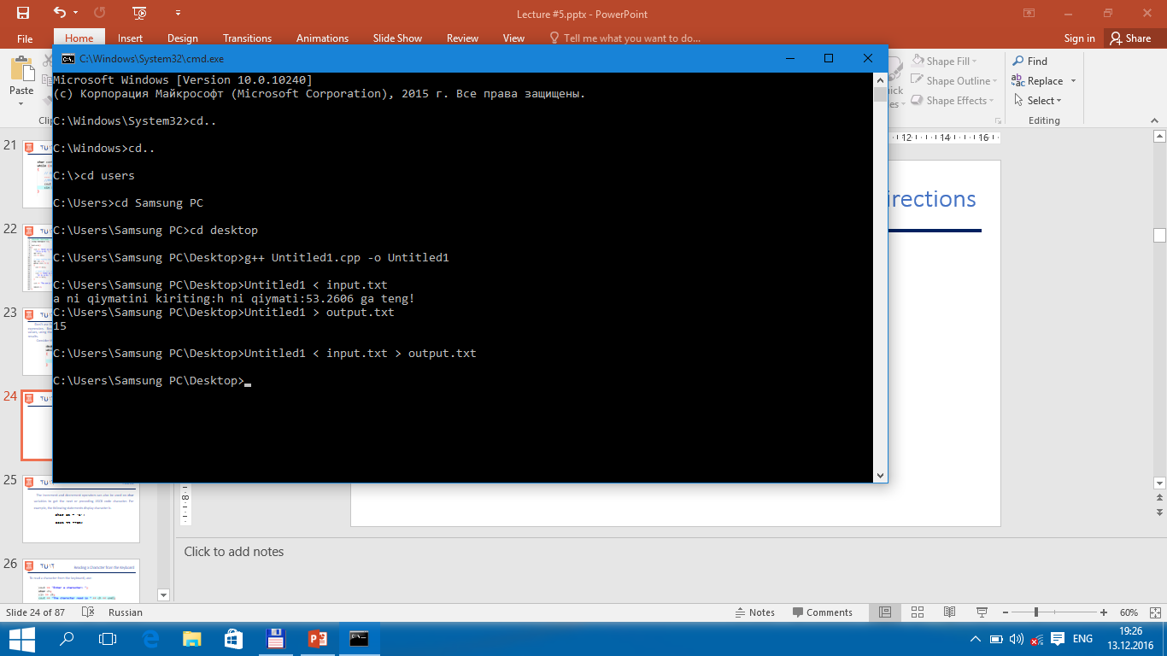
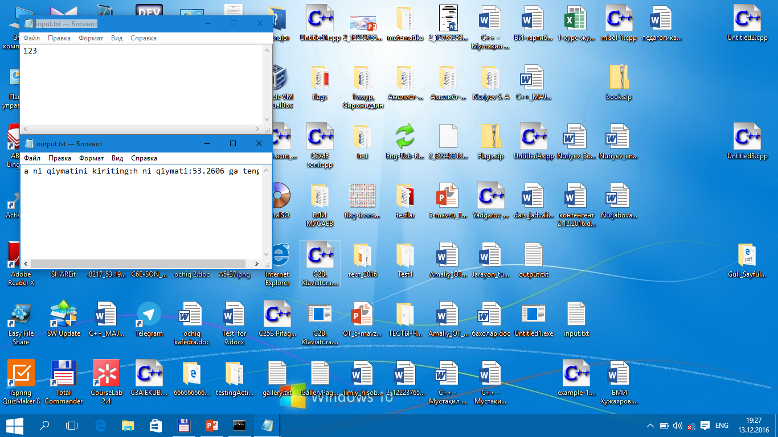
TUIT
Input and Output Redirections

Slide 25
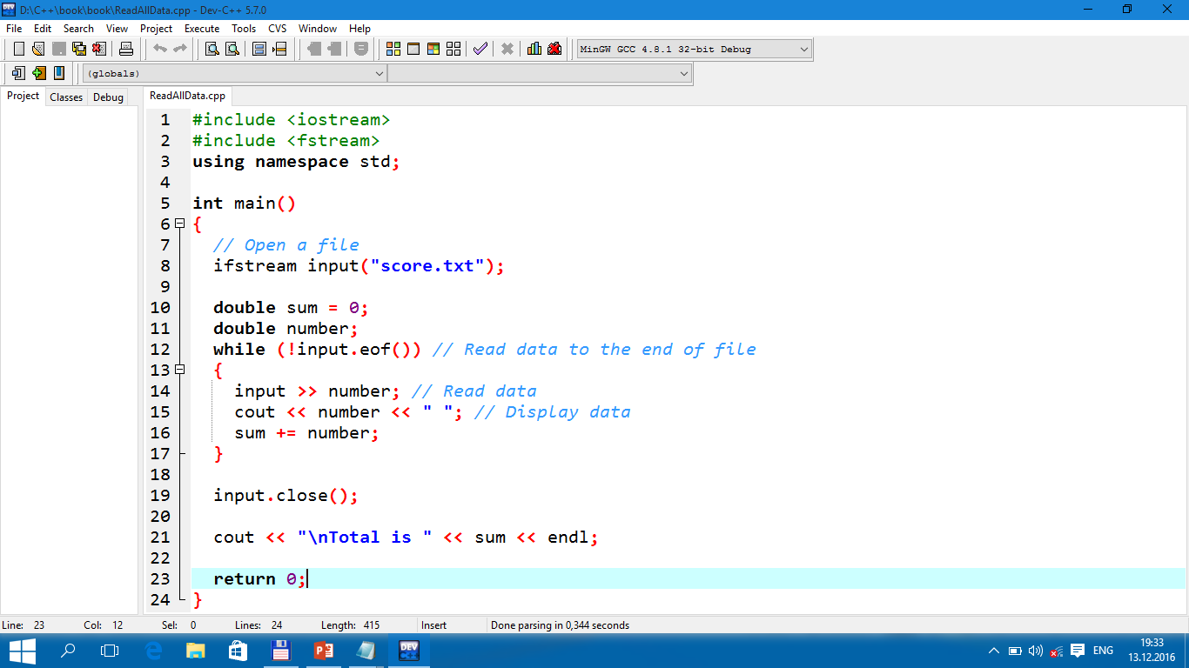
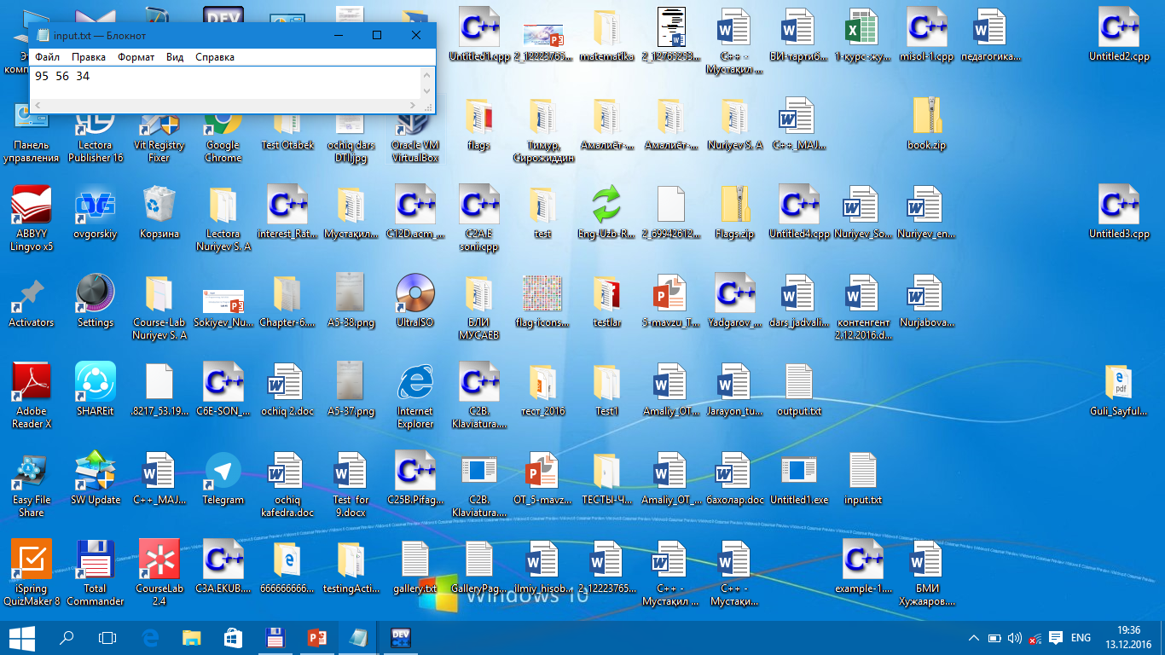
TUIT
Reading All Data from a File
Total score is 185 Done

Slide 26
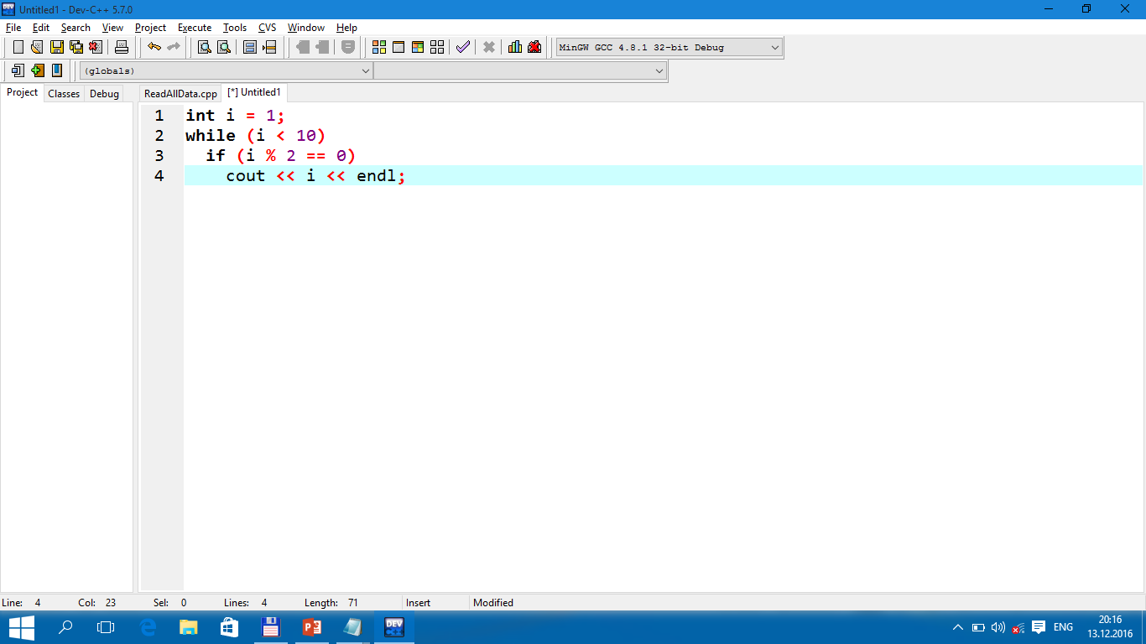


TUIT
Check Point
How many times are the following loop bodies repeated? What is the printout of each loop?

Slide 27
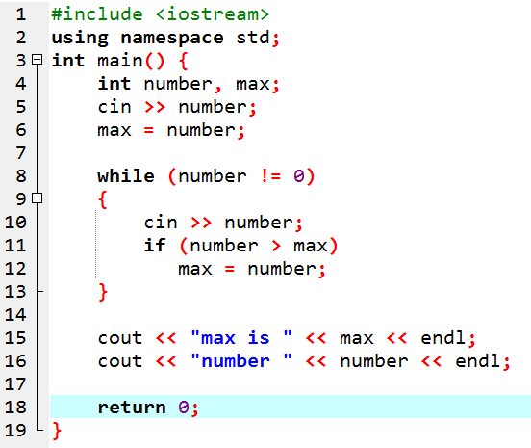
TUIT
Check Point
Suppose the input is 2 3 4 5 0. What is the output of the following code?

Slide 28
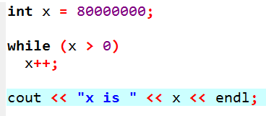
TUIT
Check Point
What is the output of the following code? Explain.

Slide 29
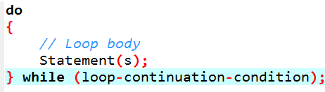
TUIT
The do-while Loop
A do-while loop is the same as a while loop except that it executes the loop body first and then checks the loop continuation condition.
The do-while loop is a variation of the while loop. Its syntax is as follows:
Statements(s)
(loop body)
Loop-continuation-condition?
true
false

Slide 30
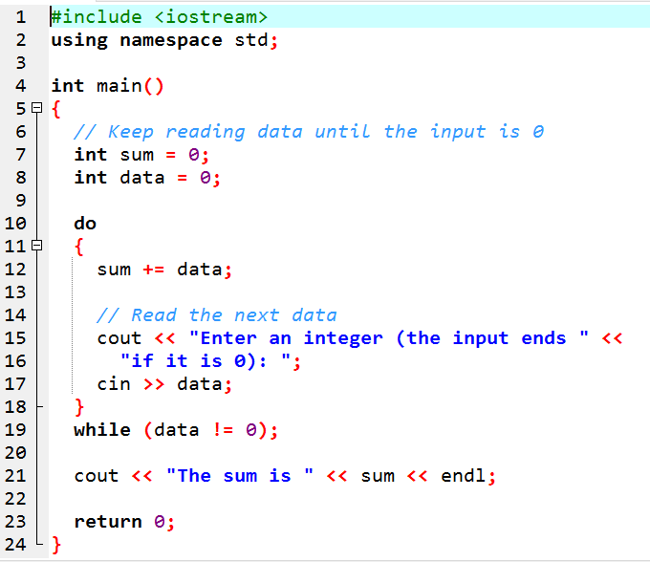
TUIT
The do-while Loop
Enter an integer (the input ends if it is 0): 3 Enter an integer (the input ends if it is 0): 5 Enter an integer (the input ends if it is 0): 6 Enter an integer (the input ends if it is 0): 0 The sum is 14

Slide 31
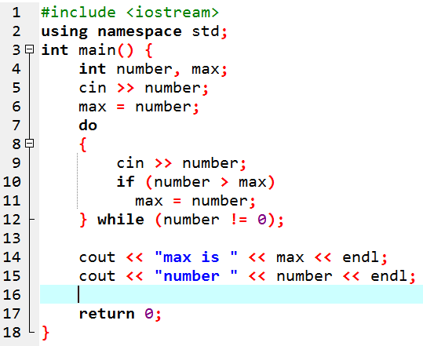
TUIT
Check Point
Suppose the input is 2 3 4 5 0. What is the output of the following code?

Slide 32
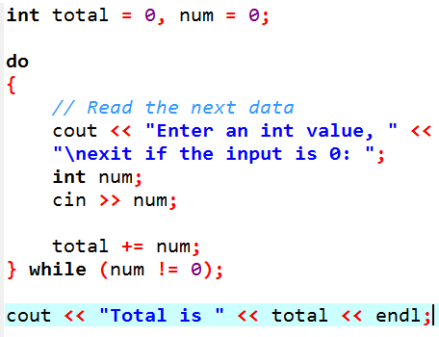
TUIT
Check Point
What is wrong in the following code?

Slide 33
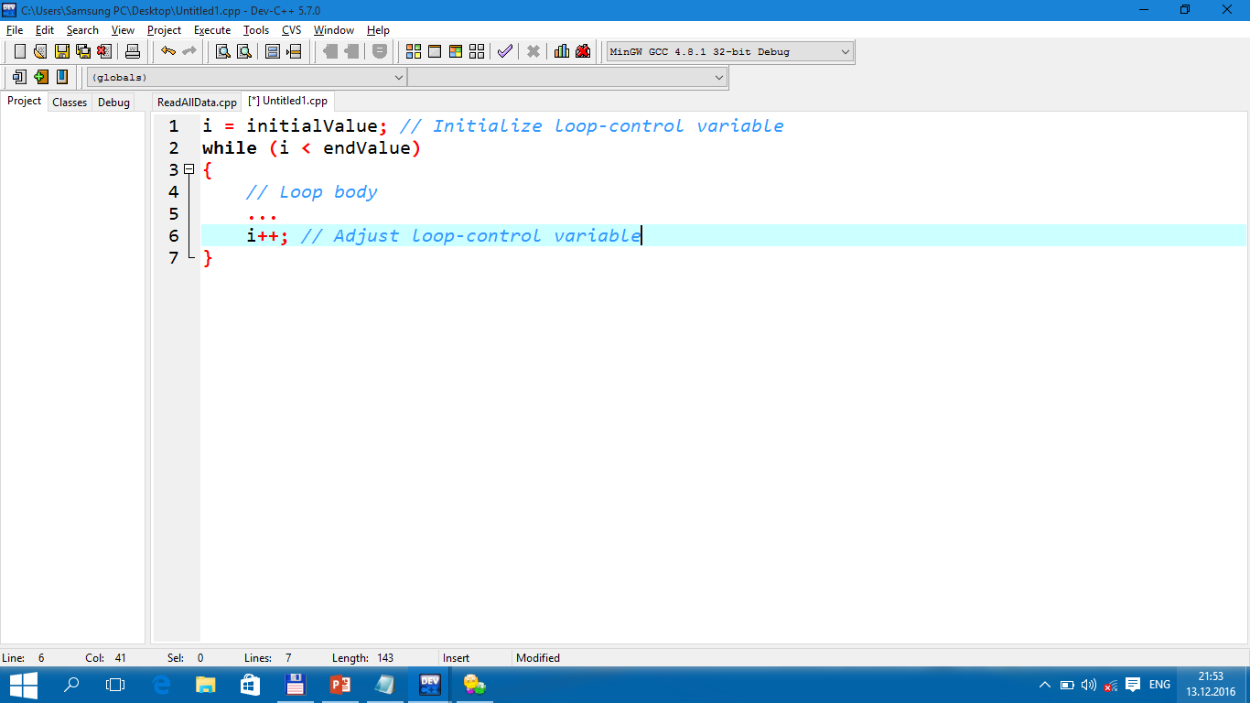
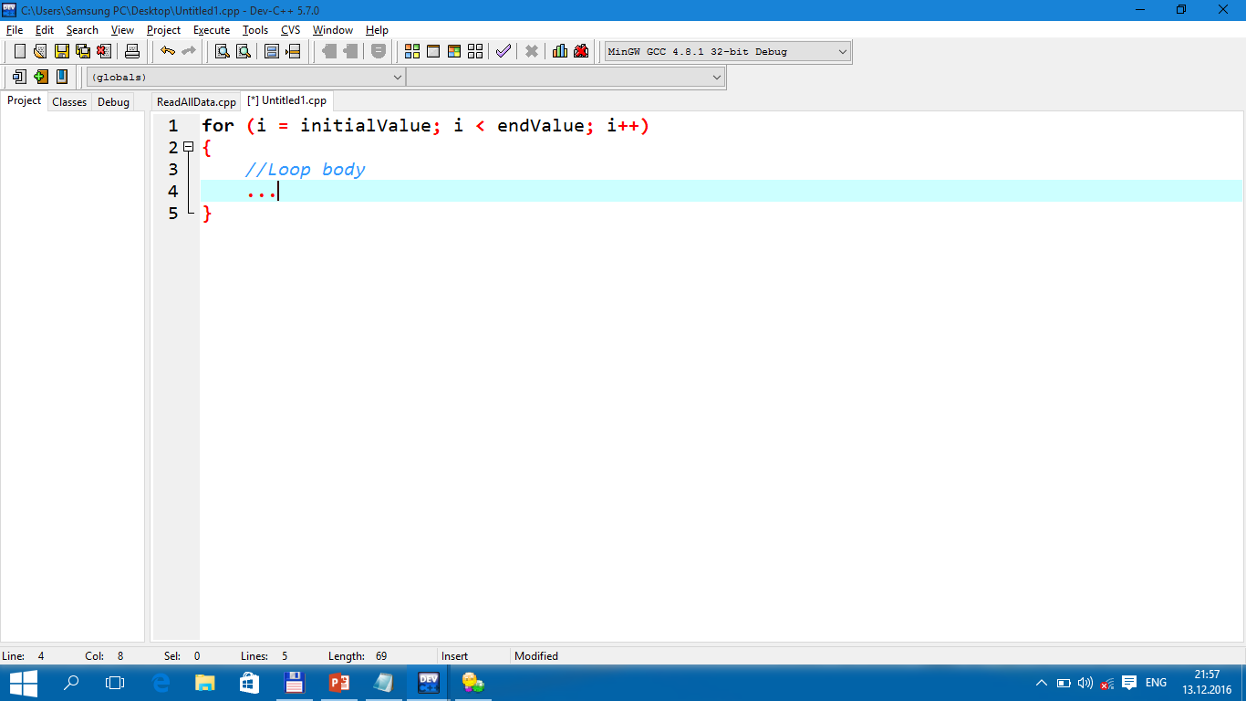
TUIT
The for Loop
A for loop has a concise syntax for writing loops.
Often you write a loop in the following common form:
A for loop can be used to simplify the above loop:

Slide 34
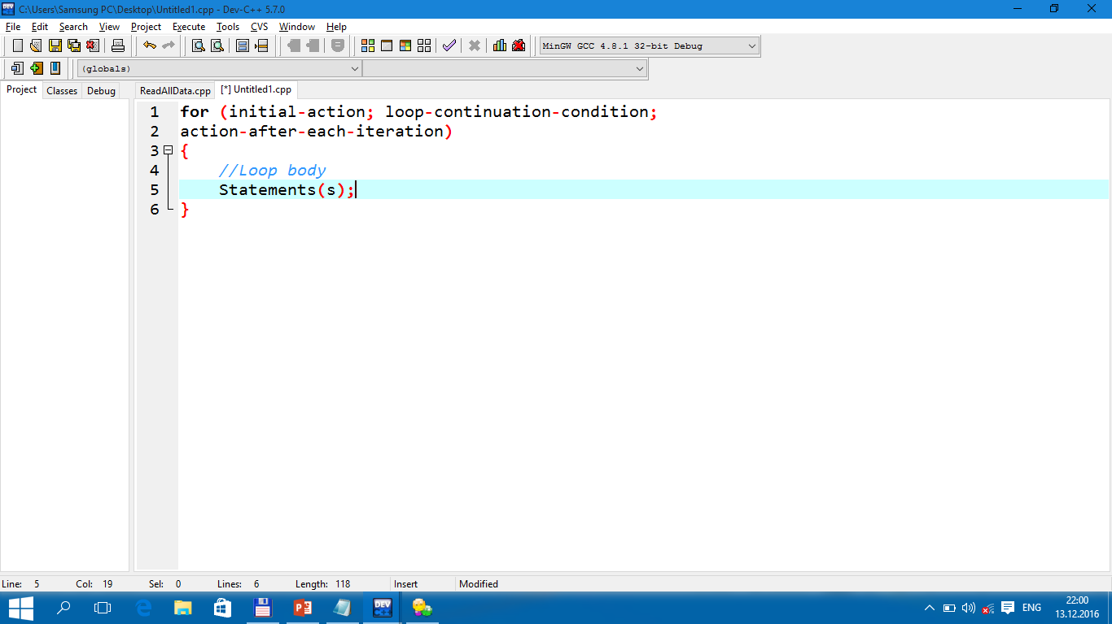
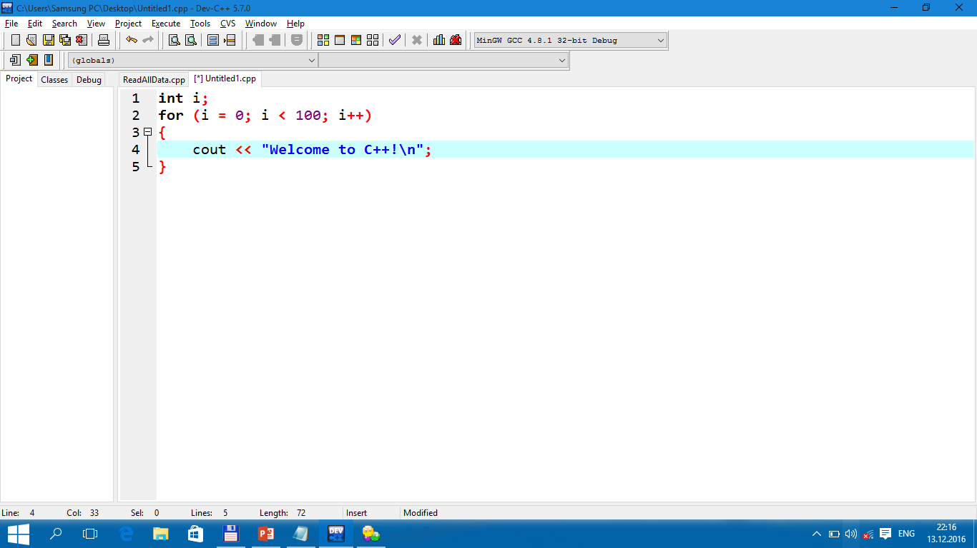
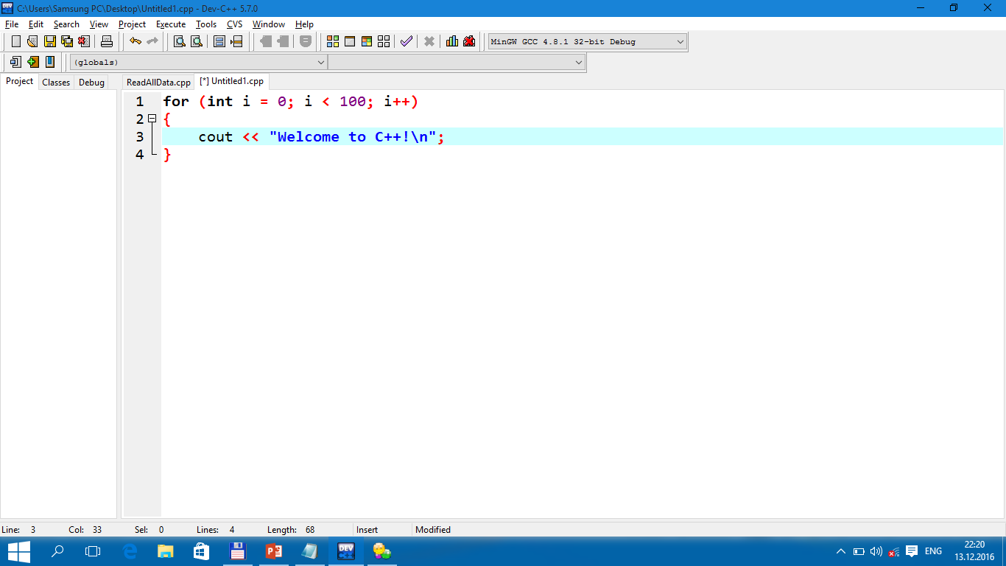
TUIT
The for Loop
In general, the syntax of a for loop is as shown below:
i = 0;
(i < 100)?
false
true
cout << “Welcome to C++!\n”;
count++;
i++;

Slide 35
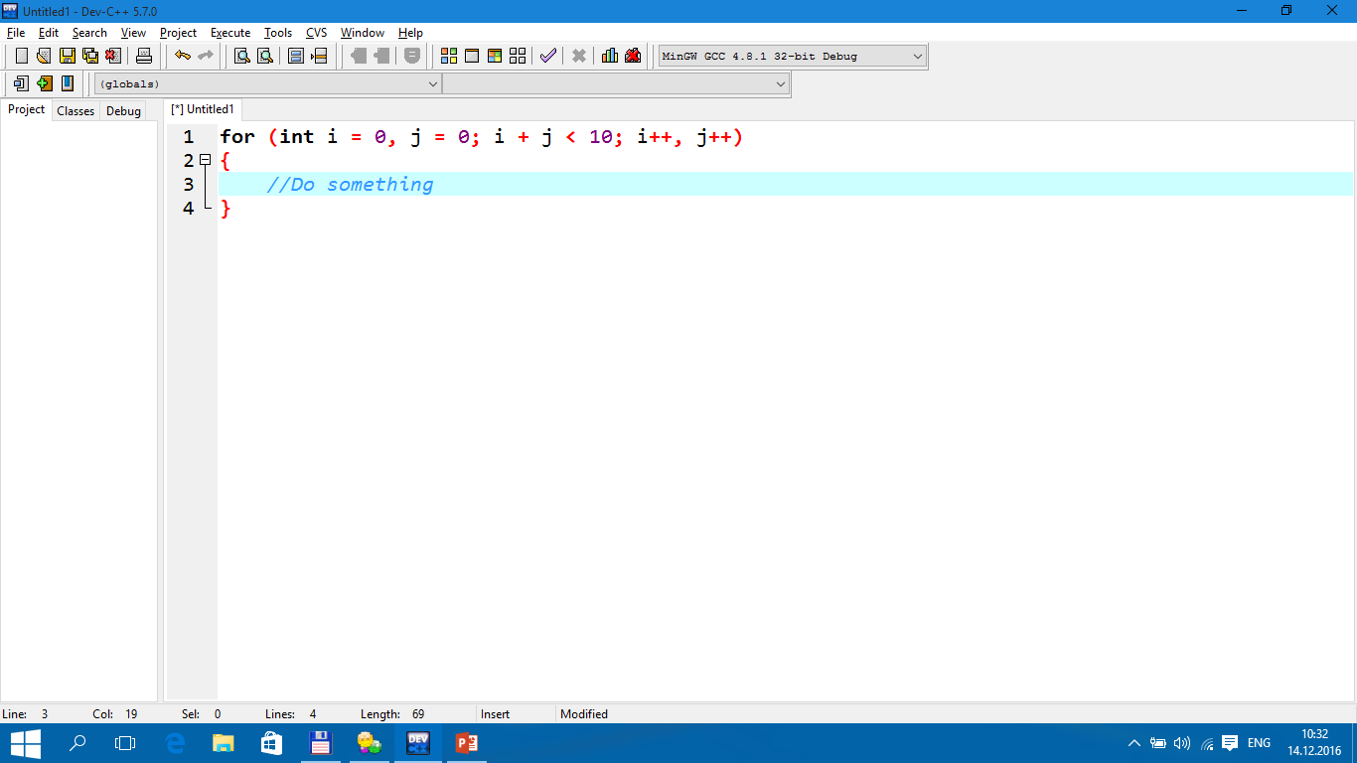
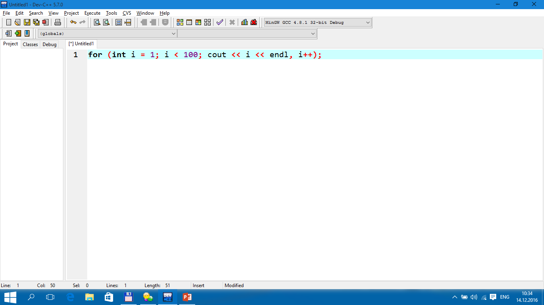
TUIT
Note
The initial-action in a for loop can be a list of zero or more comma – separated variable declaration statements or assignment expressions. For example:
The action-after-each-iteration in a for loop can be a list of zero or more comma – separated statements. For example:

Slide 36
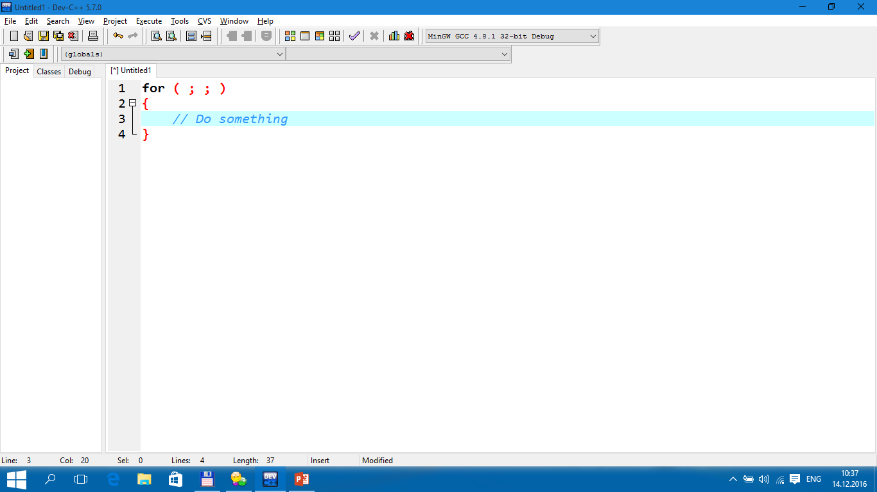
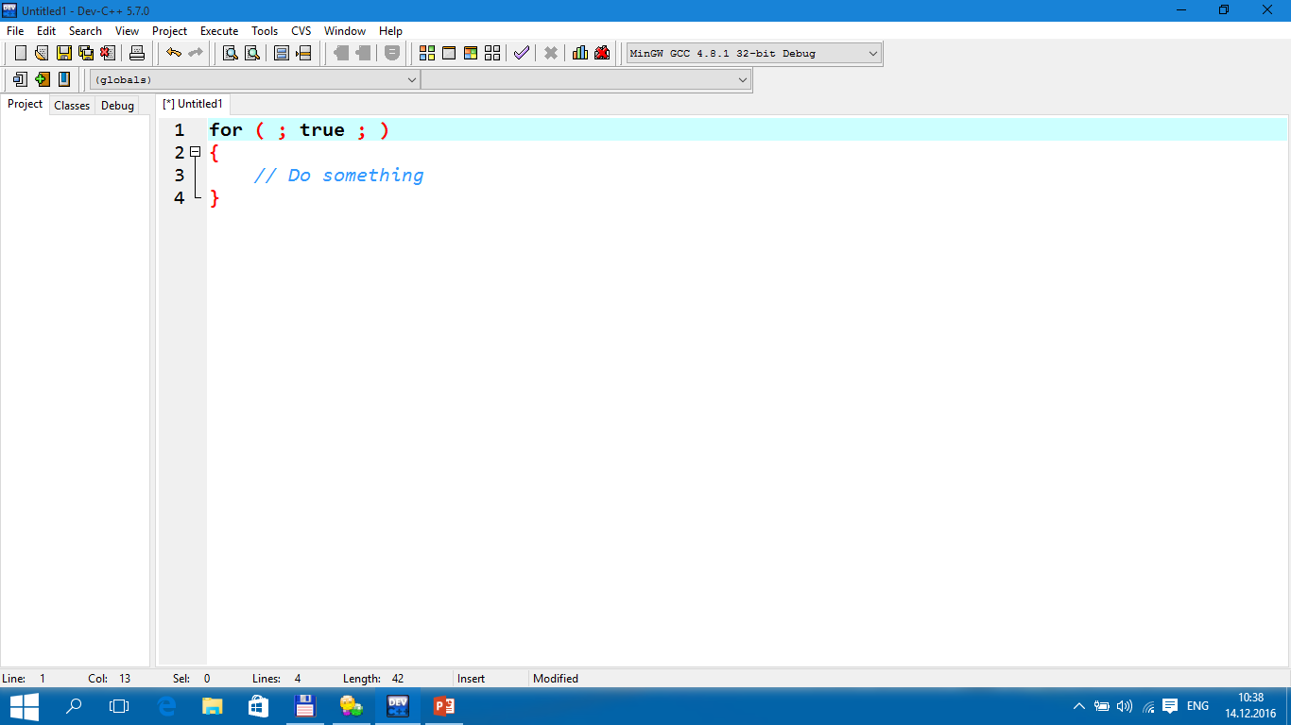
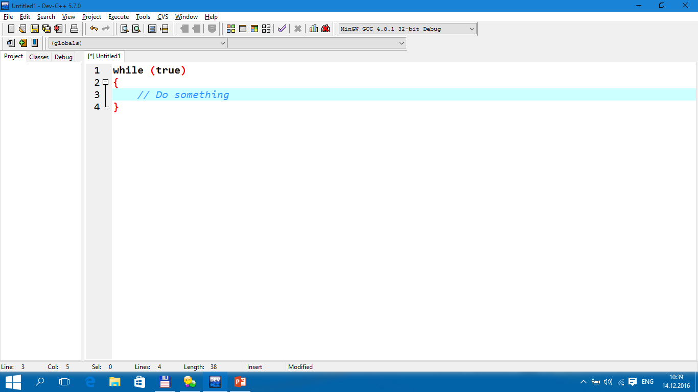
TUIT
Note
If the loop-continuation-condition in a for loop is omitted, it is implicitly true.

Slide 37
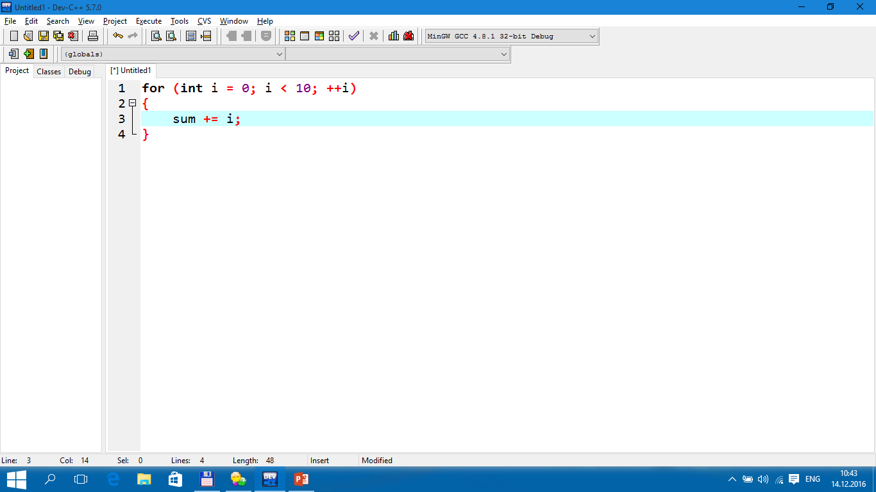
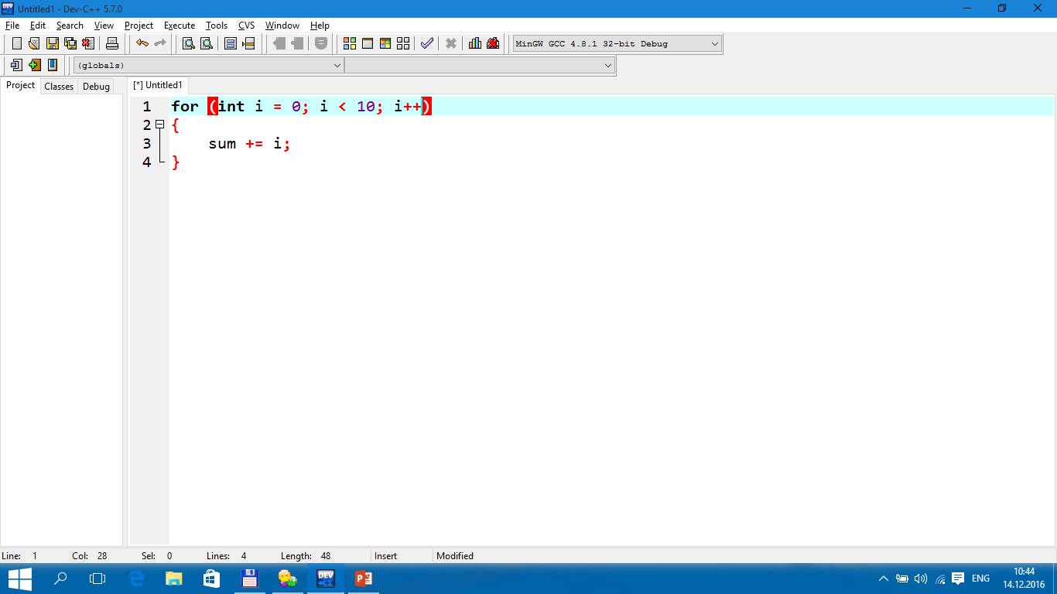
TUIT
Check Point
Do the following two loops result in the same value in sum?

Slide 38
TUIT
Check Point
What are the three parts of a for loop control? Write a for loop that prints the numbers from 1 to 100.

Slide 39
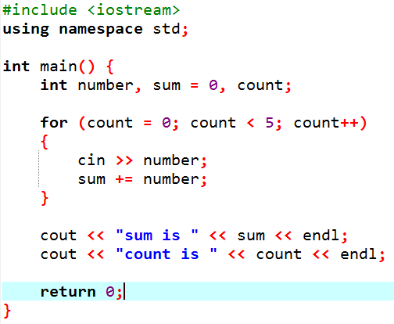
TUIT
Check Point
Suppose the input is 2 3 4 5 0. What is the output of the following code?

Slide 40
TUIT
Check Point
What does the following statement do?

Slide 41
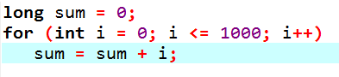
TUIT
Check Point
Convert the following for loop statement to a while loop and to a do-while loop:

Slide 42
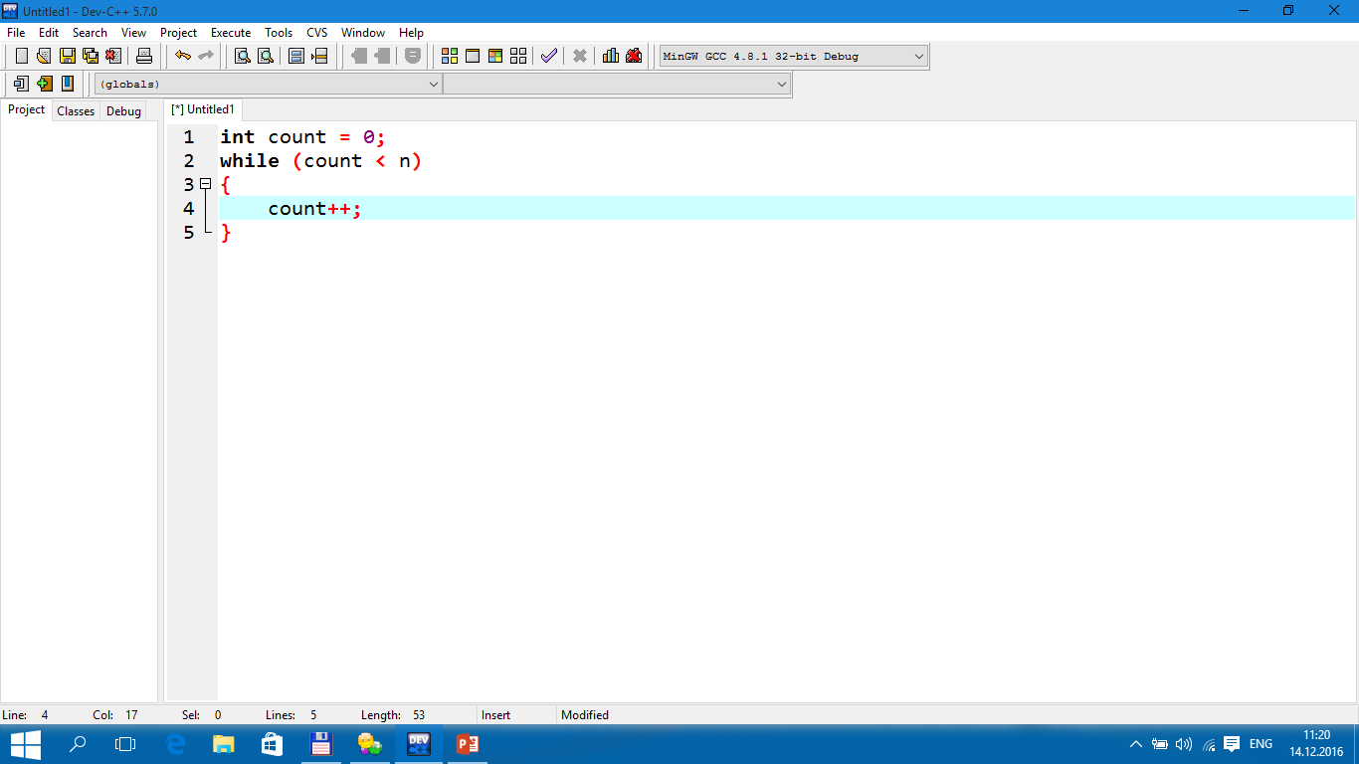
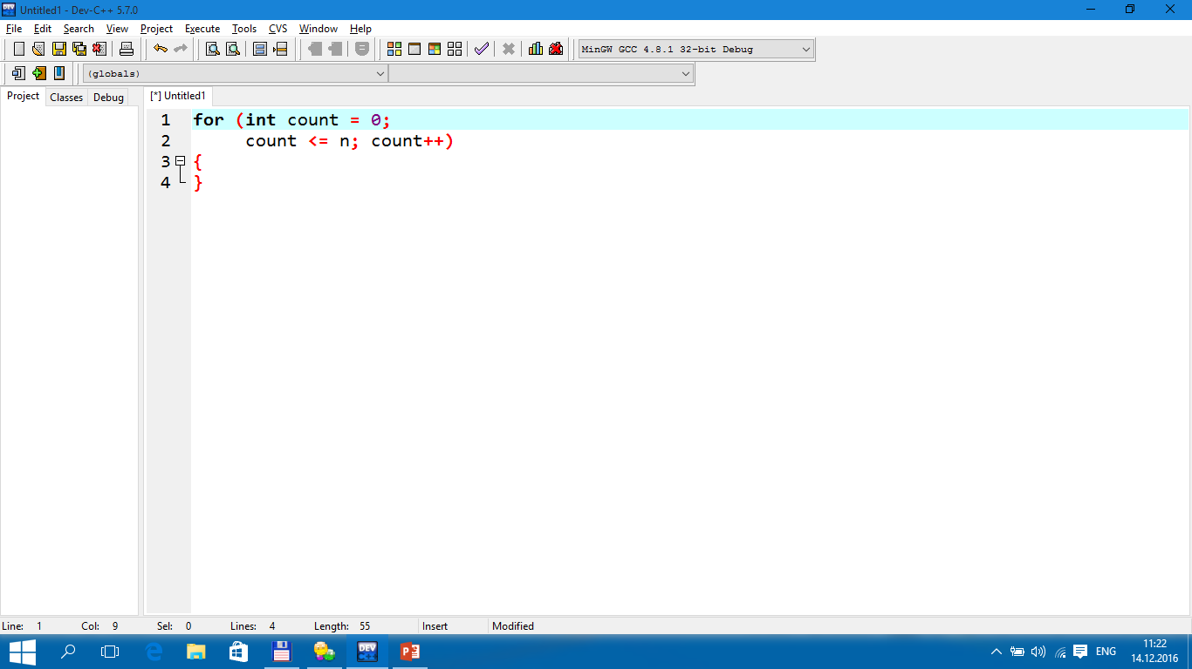
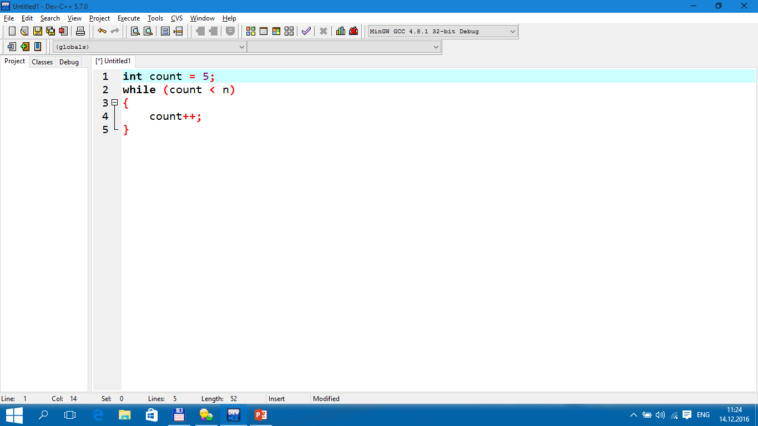
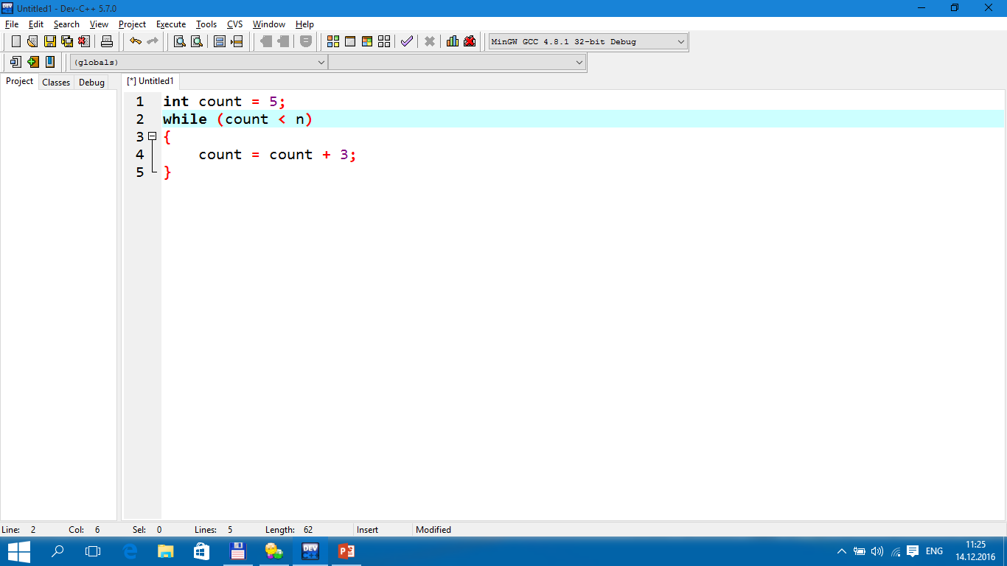
TUIT
Check Point
Count the number of iterations in the following loops:

Slide 43
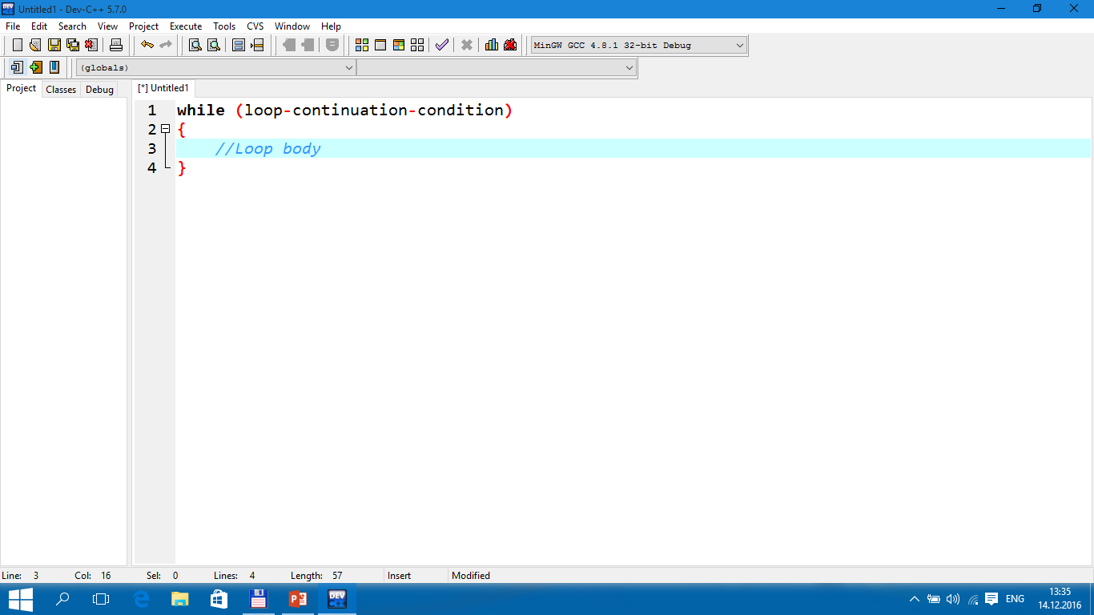

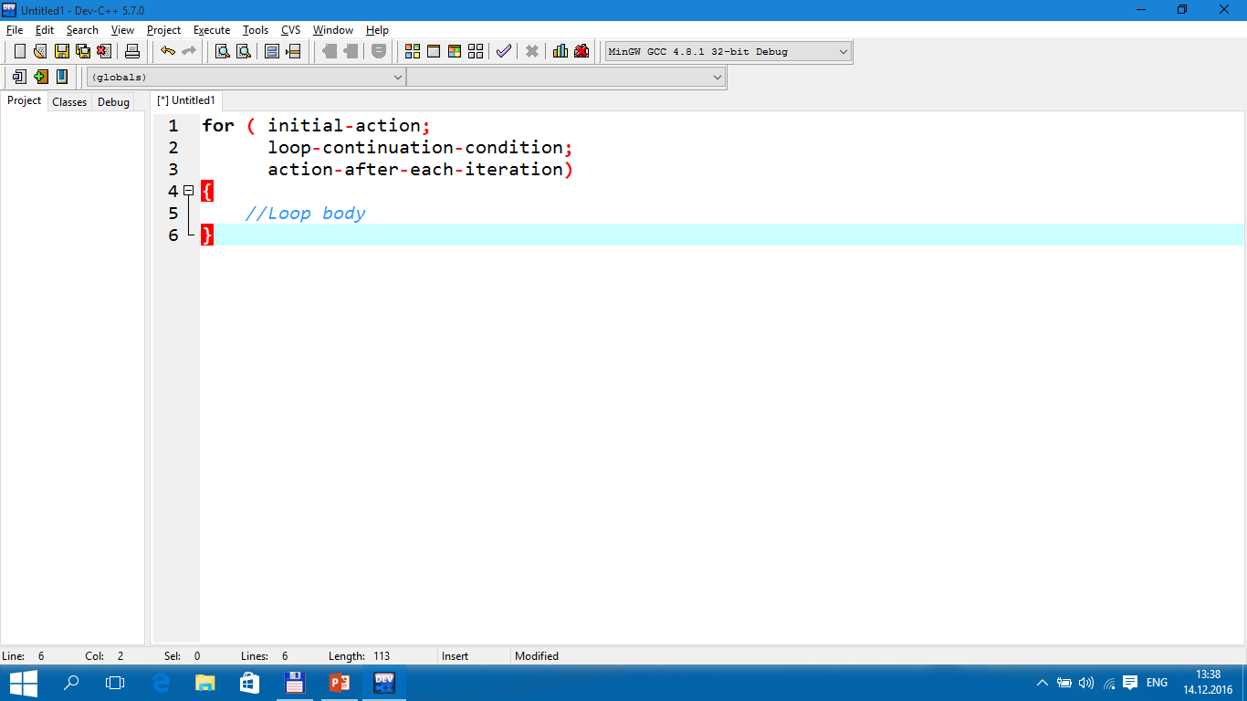
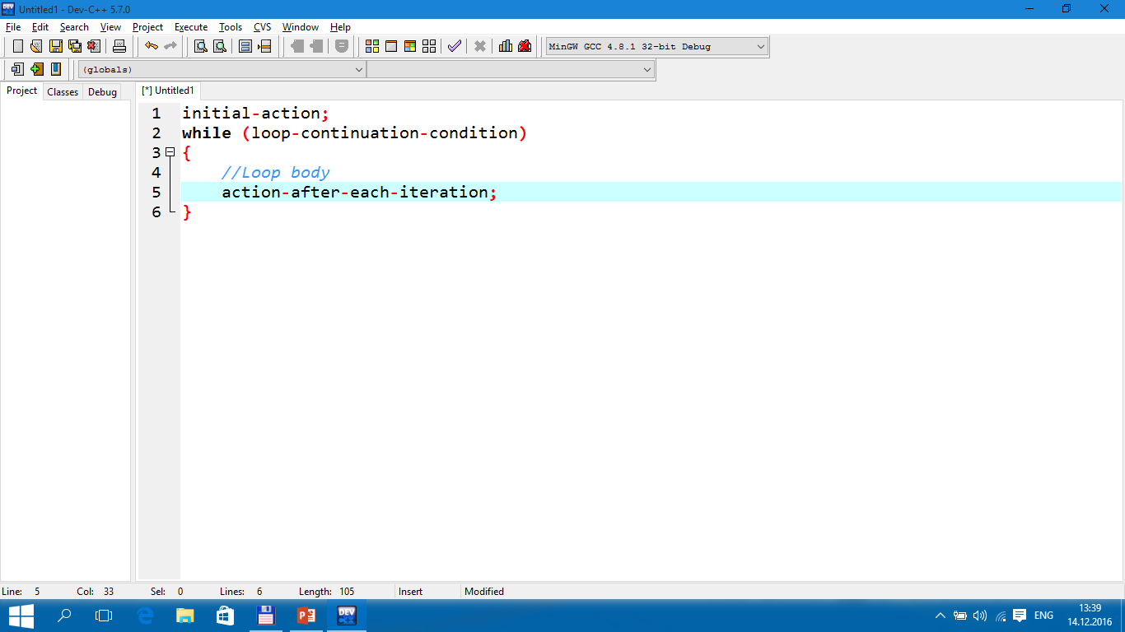
TUIT
Which Loop to Use?
You can use a for loop, a while loop, or a do-while loop, whichever is convenient.

Slide 44
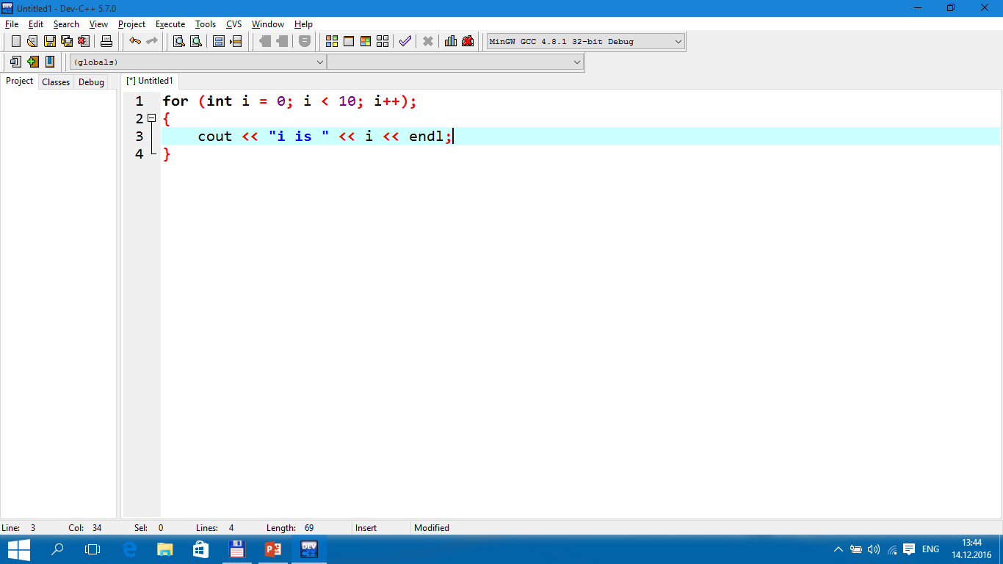

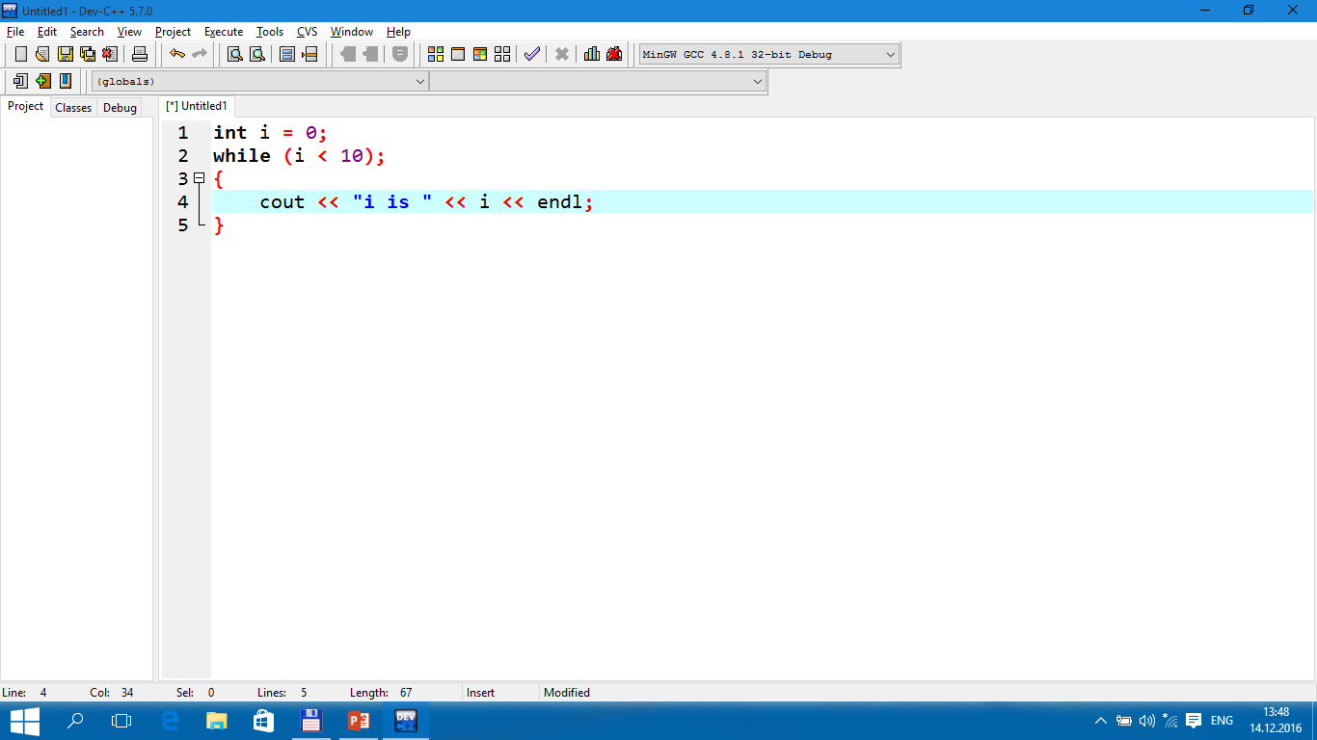

TUIT
Caution
Adding a semicolon at the end of the for clause before the loop body is a common error, as shown below.
Error
Empty Body

Slide 45

TUIT
Caution
In the case of the do-while loop, the semicolon is needed to end the loop.
Correct

Slide 46

TUIT
Check Point
Can you always convert a while loop into a for loop? Convert the following while loop into a for loop.

Slide 47

TUIT
Check Point
Identify and fix the errors in the following code:

Slide 48

TUIT
Check Point
What is wrong with the following programs?

Slide 49

TUIT
Nested Loops
Multiplication Table -------------------------------- | 1 2 3 4 5 6 7 8 9 1 | 1 2 3 4 5 6 7 8 9 2 | 2 4 6 8 10 12 14 16 18 3 | 3 6 9 12 15 18 21 24 27 4 | 4 8 12 16 20 24 28 32 36 5 | 5 10 15 20 25 30 35 40 45 6 | 6 12 18 24 30 36 42 48 54 7 | 7 14 21 28 35 42 49 56 63 8 | 8 16 24 32 40 48 56 64 72 9 | 9 18 27 36 45 54 63 72 81

Slide 50


TUIT
Note
Be aware that a nested loop may take a long time to run. Consider the following loop nested in three levels:
The action is performed 1 trillion times. If it takes 1 microsecond to perform the action, the total time to run the loop would be more than 277 hours. Note that 1 microsecond is one millionth (${10}^{−6}$) of a second.

Slide 51

TUIT
Check Point
How many times is the print statement executed?

Slide 52




TUIT
Check Point
Show the output of the following programs. (Tip: Draw a table and list the variables in the columns to trace these programs.)

Slide 53

TUIT
Minimizing Numeric Errors
Using floating-point numbers in the loop continuation condition may cause numeric errors
The sum is 49.5
The result is 49.5, but the correct result should be 50.5.

Slide 54

TUIT
Minimizing Numeric Errors
To fix the problem, use an integer count to ensure that all the numbers are added to sum. Here is the new loop:
After this loop, sum is 50.5

Slide 55
TUIT
Case Studies
Loops are fundamental in programming. The ability to write loops is essential in learning programming.
If you can write programs using loops, you know how to program! For this reason, this section presents four additional examples of solving problems using loops.

Slide 56

TUIT
Case Study: Finding the Greatest Common Divisor
Enter first integer: 125 Enter second integer: 2525 The greatest common divisor for 125 and 2525 is 25

Slide 57

TUIT
Case Study: Finding the Greatest Common Divisor
You could use a for loop to rewrite the code as follows:

Slide 58


TUIT
Case Study: Predicting the Future Tuition
Suppose that the tuition for a university is $10,000 this year and tuition increases 7% every year. In how many years will the tuition be doubled?

Slide 59

TUIT
Case Study: Predicting the Future Tuition
Tuition will be doubled in 11 years Tuition will be $21048.52 in 11 years

Slide 60

TUIT
Case Study: Monte Carlo Simulation
PI is 3.14124

Slide 61

TUIT
Case Study: Converting Decimals to Hexadecimals
Enter a decimal number: 1234 The hex number is 4D2

Slide 62

TUIT
Keywords break and continue
The break and continue keywords provide additional controls in a loop.
The number is 14 The sum is 105
Without lines 13-14, the output would be
The number is 20 The sum is 210

Slide 63

TUIT
Keywords break and continue
You can also use the continue keyword in a loop.
The sum is 189
Without lines 12-13, the output would be as follows:
The sum is 210

Slide 64


TUIT
Keywords break and continue
Suppose you need to write a program to find the smallest factor other than 1 for an integer n (assume n >= 2). You can write a simple and intuitive code using the break statement as follows:
Too many break and continue statements will produce a loop with many exit points and make the program difficult to read.

Slide 65
TUIT
Note
Some programming languages including C++ have a goto statement indiscriminately transfers control to any statement in the program and executes it. This makes your program vulnerable to errors. The break and continue statements in C++ are different from goto statements.

Slide 66


TUIT
Check Point
What is the keyword break for? What is the continue for? Will the following programs terminate? If so, give the output.

Slide 67


TUIT
Check Point
The for loop on the left is converted into the while loop on the right. What is wrong? Correct it
Converted
Wrong
conversation

Slide 68


TUIT
Check Point
After the break statement in (a) is executed in the following loop, which statement is executed? Show the output. After the continue statement in (b) is executed in the following loop, which statement is executed? Show the output.
(a)
(b)

Slide 69

TUIT
Case Study: Checking Palindromes
This section presents a program that tests whether a string is a palindrome. A string is a palindrome if it reads the same forward and backward. The words “mom”, “dad”, and “noon”, for example, are palindromes.

Slide 70

TUIT
Case Study: Checking Palindromes
Enter a string: abccba abccba is a palindrome
Enter a string: abca abca is not a palindrome

Slide 71
TUIT
Case Study: Displaying Prime Numbers
This section presents a program that displays the first 50 prime numbers in 5 lines each containing 10 numbers.
An integer greater than 1 is prime if its only positive divisor is 1 or itself. For example, 2, 3, 4, and 7 are prime numbers, but 4, 6, 8, and 9 are not. The program can be broken into the following tasks:
Determine whether a given number is prime.
For number = 2, 3, 4, 5, 6, … , test whether it is prime.
Count the prime numbers.
Display each prime number, and display ten numbers per line.

Slide 72

TUIT
Case Study: Displaying Prime Numbers
Here is the algorithm:
Set the number of prime numbers to be printed as a constant NUMBER_OF_PRIMES;
Use count to track the number of prime numbers and set an initial count to 0;
Set an initial number to 2;

Slide 73

TUIT
Case Study: Displaying Prime Numbers
To test whether a number is prime, check whether it is divisible by 2, 3, 4, up to number/2. If a divisor is found, the number is not a prime. The algorithm can be described as follows:

Slide 74


TUIT
Case Study: Displaying Prime Numbers
The first 50 prime numbers are 2 3 5 7 11 13 17 19 23 29 31 37 41 43 47 53 59 61 67 71 73 79 83 89 97 101 103 107 109 113 127 131 137 139 149 151 157 163 167 173 179 181 191 193 197 199 211 223 227 229

Slide 75
TUIT
Summary
There are three types of repetition statements: the while loop, the do-while loop, and the for loop.
The part of the loop that contains the statements to be repeated is called the loop body.
A one-time execution of a loop body is referred to as an iteration of the loop.
An infinite loop is a loop statement that executes infinitely.
In designing loops, you need to consider both the loop control structure and the loop.
The while loop checks the loop-continuation-condition first. If the condition is true, the loop body is executed; if it is false, the loop terminates.

Slide 76
TUIT
Summary
The do-while loop is similar to the while loop, expect that the do-while loop executes the loop body first and then checks the loop-continuation-condition to decide whether to continue or to terminate.
The while loop and the do-while loop often are used when the number of repetitions is not predetermined.
A sentinel value is a special value that signifies the end of the loop.
The for loop generally is used to execute a loop body a fixed number of times.
The while loop and for loop are called pretest loops because the continuation condition is checked before the loop body is executed.
Two keywords, break and continue, can be used in a loop.
The break keyword immediately ends the innermost loop, which contains the break. The continue keyword only ends the current iteration.

